Slide 1
Next Generation FireWalls(NGF)
and
Intrusion Prevension Systems(IPS)
Both used to secure network but they have different approches.
Traditional FireWalls
-They sits on the way of packet traffic. Decides which packet to allow and which to allow.
-Traffic control (as ACLs does).
- But many detailed controls are done by FWs.
- Content and URL filtering
- Can be Stateless Firewall which no connection track(ie. TCP traffic)
- Can be Statefull Firewall (tracking of TCP connection,or inside to outside traffic)
- Tracking number of TCP connections per second.
- Tracking huge TCP connections from same source IP address for DoS atatcks.
- Divides network to Security Levels and weight them as the level of trust. Then permit traffic
from more secure zone to less secure zone and deny vice versa(Rules from Zone to Zone)
© 2007 Cisco Systems, Inc. All rights reserved.
ICND2 v1.0—5-14
The PDF files and any printed representation for this material are the property of Cisco Systems, Inc., for the sole use by Cisco employees for personal study. The files or printed representations may not be used in commercial training, and may not be distributed for purposes other than individual self-study.

Slide 2
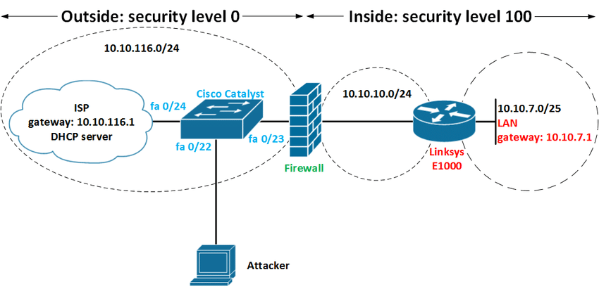
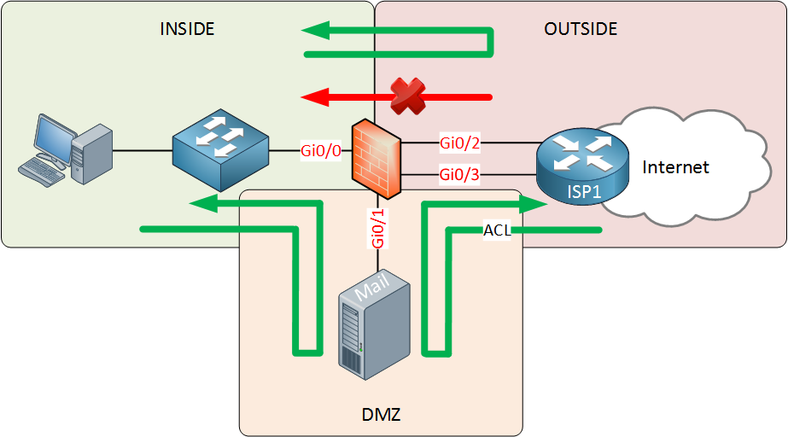
NGFWs and IPS
Traditional FireWalls
For example:
Inside has Security Level 100
DMZ has Security Level 50
Outside has Security Level 0
© 2007 Cisco Systems, Inc. All rights reserved.
ICND2 v1.0—5-14
The PDF files and any printed representation for this material are the property of Cisco Systems, Inc., for the sole use by Cisco employees for personal study. The files or printed representations may not be used in commercial training, and may not be distributed for purposes other than individual self-study.

Slide 3
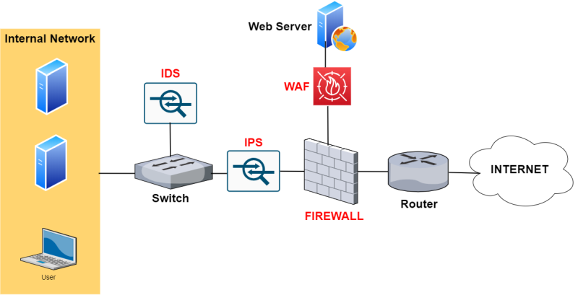
NGFWs and IPS
Traditional IPS
IPS also can sit on the packet path ,can filter packets but decisions are made
in a different manner. IPS downloads the exploit sigantures (harmful SW signature) and
Inspects packets according to those signatures and discards or redirects packtes.If necessary
shuts down ports to prevent harmful traffic.
But IPS rules not defined by network managers rather defined by IPS vendors.
IPS has a signature database and looks for signature for DoS,DDoS,Worms,Viruses .
This databas eneed to updated.
Signature
DB
© 2007 Cisco Systems, Inc. All rights reserved.
ICND2 v1.0—5-14
The PDF files and any printed representation for this material are the property of Cisco Systems, Inc., for the sole use by Cisco employees for personal study. The files or printed representations may not be used in commercial training, and may not be distributed for purposes other than individual self-study.

Slide 4
NGFWs and IPS
Traditional IPS
The IPS performs real-time packet inspection, deeply inspecting every packet that travels across the network. If any malicious or suspicious packets are detected, the IPS will carry out one of the following actions:
- Terminate the TCP session that has been exploited.
- Block the offending source IP address or user account from accessing any application, target hosts or other network resources unethically.
- Reprogram or reconfigure the firewall to prevent a similar attack from occurring in the future.
- Remove or replace any malicious content that remains on the network following an attack. This is done by repackaging payloads, removing header information and removing any infected attachments from file or email servers.
Zero-Day Atatck ?
Virus attacks until IPS gets signature.
© 2007 Cisco Systems, Inc. All rights reserved.
ICND2 v1.0—5-14
The PDF files and any printed representation for this material are the property of Cisco Systems, Inc., for the sole use by Cisco employees for personal study. The files or printed representations may not be used in commercial training, and may not be distributed for purposes other than individual self-study.

Slide 5
NGFWs and IPS
Next Generation FWs
After 2010 Work force distrubeted and different kind of applications(such as Mobile)
connectios to the enterprise over internet are rised.
Attackers knows applications and well known ports for port scanning to find a hole.
For devices that handel these changes next-generation term are started to use.
Cisco uses next-generation FWs and IPSs.
Cisco has ASA and FirePower F/W IPS apliances.
NGFWs
- Have traditional FW capabilities.
- Instead of ports can look to application layer data(layer 2 to 7)
- Application Visibility& Control(AVC)-Cisco
- Network based anti-Malware control
- URL filtering
- Next Generation IPS on NGFW.
© 2007 Cisco Systems, Inc. All rights reserved.
ICND2 v1.0—5-14
The PDF files and any printed representation for this material are the property of Cisco Systems, Inc., for the sole use by Cisco employees for personal study. The files or printed representations may not be used in commercial training, and may not be distributed for purposes other than individual self-study.

Slide 6
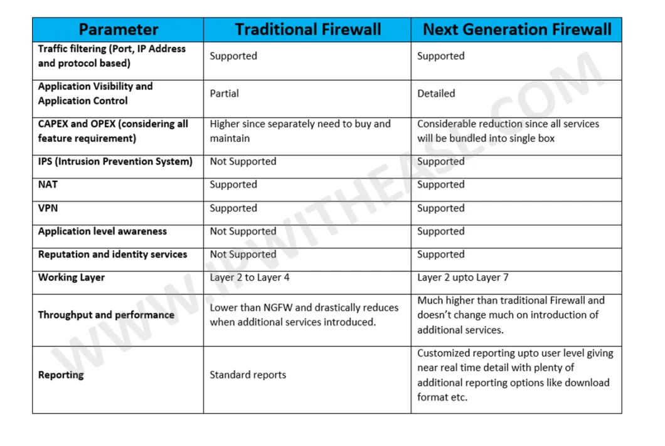
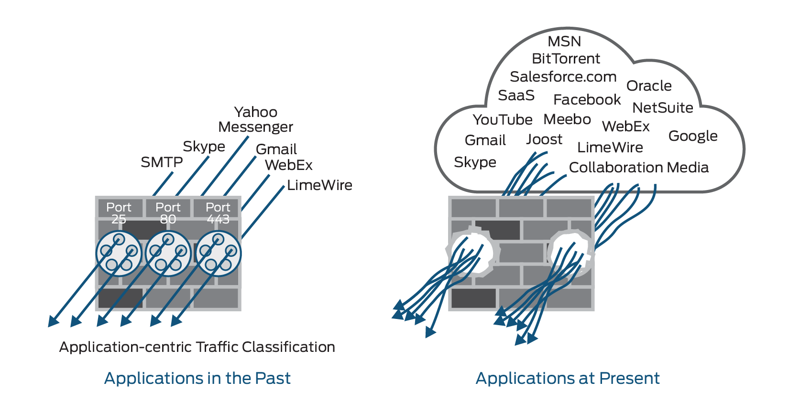
Traditional and NGFWs
Capital and operational expences
IP ve Kimlik güvenilirliği
New pplication types
Over loaded on port 80
Application visibility needed
© 2007 Cisco Systems, Inc. All rights reserved.
ICND2 v1.0—5-14
The PDF files and any printed representation for this material are the property of Cisco Systems, Inc., for the sole use by Cisco employees for personal study. The files or printed representations may not be used in commercial training, and may not be distributed for purposes other than individual self-study.

Slide 7
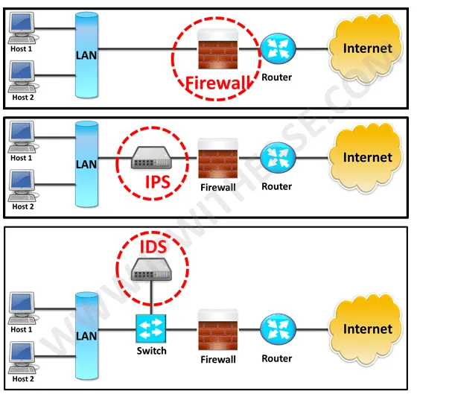
NGFWs and IPS
Next Generation IPS
They are mostly integrated with next-gen FWs.
Capability of traditional IPS.
Gathering data from Hosts and Users.
Knows Operating Systems,Applications,OS Versions,open ports,used ports etc..
Logs what happings inteligently.
Application Visibility and Control(AVC)
Prevents network attacks by detecting abnormal patterns with these informations.
© 2007 Cisco Systems, Inc. All rights reserved.
ICND2 v1.0—5-14
The PDF files and any printed representation for this material are the property of Cisco Systems, Inc., for the sole use by Cisco employees for personal study. The files or printed representations may not be used in commercial training, and may not be distributed for purposes other than individual self-study.

